Slide 1
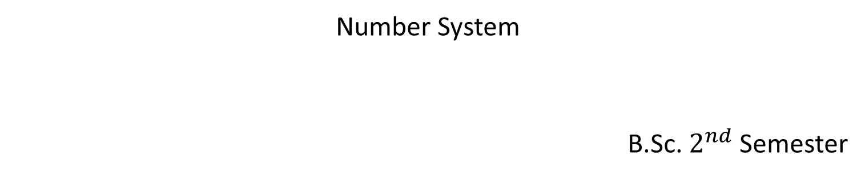
Digital Logic and Circuit
Number System
B.Sc. $2^{nd}$ Semester

Slide 2
Introduction
Information representation
Elementary storage units inside computer are electronic switches. Each switch holds one of two states: on (1) or off (0). We use a bit (binary digit), 0 or 1, to represent the state.
Storage units can be grouped together to cater for larger range of numbers
1 → 01
2 → 10
3 → 11
4 → 100

Slide 3

N bits can represent $2^{N}$ different values.
example:
1 bit = $2^{1}$= 2 different values
values are 0 and 1.
2 bit = $2^{2}$ = 4 different values
values 00, 01, 10, 11
00 → 0
01 → 1
10 → 2
11 → 3

Slide 4
Test
If the number of bits are 4 then the values are??
100 values require how many bits??
1024 values require how many bits??

Slide 5

For M values $\left\lceil \log_{2}{M}\right\rceil$
100 values $→$ 7 bits
1024 values $→$ 10 bits
64 values $→$ 6 bits
40 values $→$ 6 bits

Slide 6
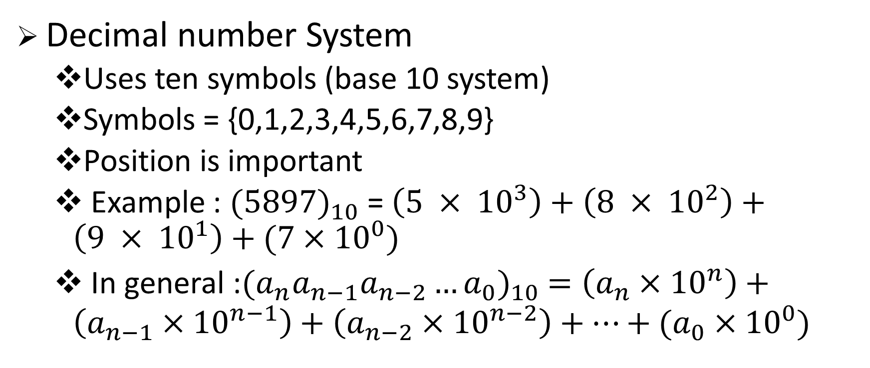
Position Notation
Decimal number System
Uses ten symbols (base 10 system)
Symbols = {0,1,2,3,4,5,6,7,8,9}
Position is important
Example : ${(5897)}_{10}$ = $\left(5 × {10}^{3}\right)+\left(8 × {10}^{2}\right)+\left(9 × {10}^{1}\right)+(7×{10}^{0})$
In general :${(a_{n}a_{n−1}a_{n−2}…a_{0})}_{10} =\left(a_{n}×{10}^{n}\right)+\left(a_{n−1}×{10}^{n−1}\right)+\left(a_{n−2}×{10}^{n−2}\right)+…+(a_{0}×{10}^{0})$

Slide 7
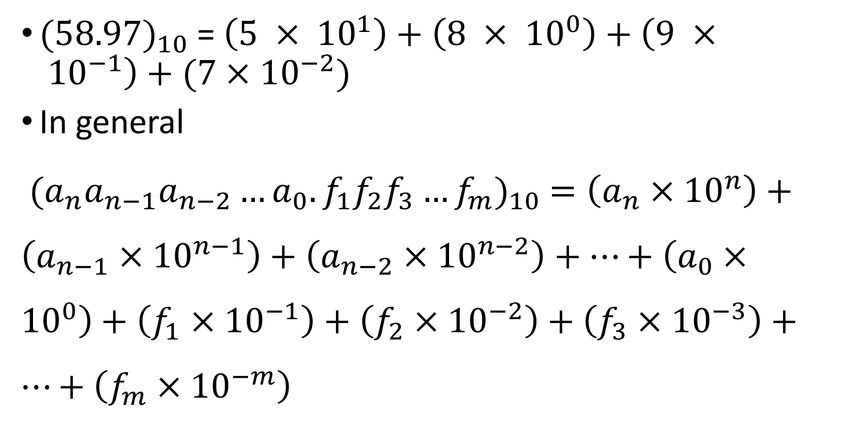
${(58.97)}_{10}$ = $\left(5 × {10}^{1}\right)+\left(8 × {10}^{0}\right)+\left(9 × {10}^{−1}\right)+(7×{10}^{−2})$
In general
${(a_{n}a_{n−1}a_{n−2}…a_{0}.f_{1}f_{2}f_{3}…f_{m})}_{10} =\left(a_{n}×{10}^{n}\right)+\left(a_{n−1}×{10}^{n−1}\right)+\left(a_{n−2}×{10}^{n−2}\right)+…+\left(a_{0}×{10}^{0}\right)+\left(f_{1}×{10}^{−1}\right)+\left(f_{2}×{10}^{−2}\right)+\left(f_{3}×{10}^{−3}\right)+…+\left(f_{m}×{10}^{−m}\right)$

Slide 8
Other number System
Binary (base 2) : weights in power of 2.
Binary digits (bits) : 0, 1
Octal (base 8) : weights in power of 8.
Octal digits : 0,1,2,3,4,5,6,7
Hexadecimal (base 16) : weights in power of 16
Hexadecimal digits : 0,1,2,3,4,5,6,7,8,9,A,B,C,D,E,F

Slide 9
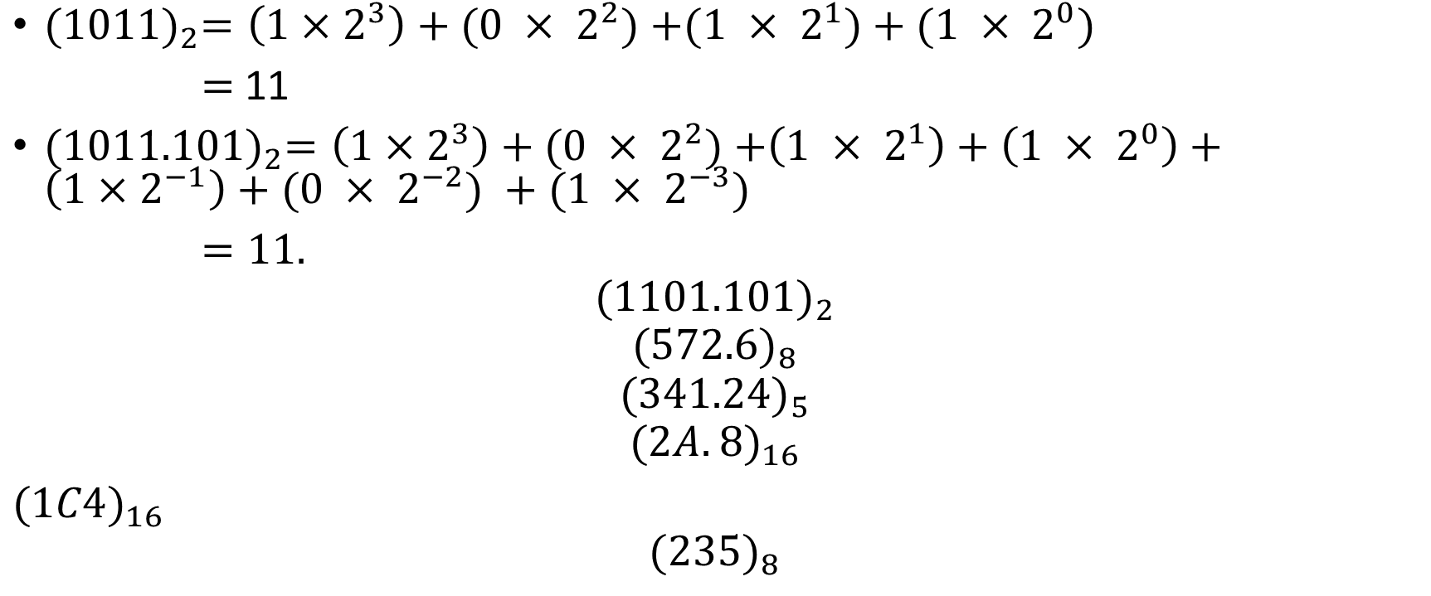
Base R – to - decimal conversion
${(1011)}_{2}=\left(1×2^{3}\right)+(0 × 2^{2})$ $+(1 × 2^{1})+(1 × 2^{0})$
$=$ 11
${(1011.101)}_{2}=\left(1×2^{3}\right)+(0 × 2^{2})$ $+\left(1 × 2^{1}\right)+\left(1 × 2^{0}\right)+\left(1×2^{−1}\right)+(0 × 2^{−2}) +(1 × 2^{−3})$
$=11.$
$${(1101.101)}_{2}$$
$${(572.6)}_{8}$$
$${(341.24)}_{5}$$
$${(2A.8)}_{16}$$
${(1C4)}_{16}$
$${(235)}_{8}$$

Slide 10
Decimal to Binary Conversion
Method 1: Sum-of-Weights Method
Method 2:
Repeated Division-by-2 Method (for whole numbers)
Repeated Multiplication-by-2 Method (for fractions)

Slide 11
Sum-of-Weights Method
Determine the set of binary weights whose sum is equal to the decimal number.
(9)₁₀ = 8 + 1 = 2³ + 2⁰ = (1001)₂
(18)₁₀ = 16 + 2 = 2⁴ + 2¹ = (10010)₂
(58)₁₀ = 32 + 16 + 8 + 2 = 2⁵ + 2⁴ + 2³ + 2¹
= (111010)₂
(0.625)₁₀ = 0.5 + 0.125 = 2⁻¹ + 2⁻³
= (0.101)₂

Slide 12
Repeated Division-by-2 Method
To convert a whole number to binary, use successive division by 2 until the quotient is 0. The remainders form the answer, with the first remainder as the least significant bit (LSB) and the last as the most significant bit (MSB).
(43)₁₀ = (101011)₂

Slide 13
Repeated Multiplication-by-2 Method
To convert decimal fractions to binary, repeated multiplication by 2 is used, until the fractional product is 0 (or until the desired number of decimal places). The carried digits, or carries, produce the answer, with the first carry as the MSB, and the last as the LSB.
(0.3125)₁₀ = (.0101)₂

Slide 14
Conversion between Decimal and other Bases
Decimal to base-R
whole numbers: repeated division-by-R
fractions: repeated multiplication-by-R

Slide 15
Conversion between Bases
In general, conversion between bases can be done via decimal:
Base-2 Base-2
Base-3 Base-3
Base-4 Decimal Base-4
… ….
Base-R Base-R

Slide 16
Test
Example: Your Number is (321) in base 4 Then, 3×4^2 + 2×4^1 + 1×4^0=3×16 + 2×4 + 1×1=48+8+1=57
So, 421 in base 4 is 57 in decimal.
Now convert 57 in decimal to Octal: We get: 71 (Do the Math yourself, Divide it by 8 and store the remainder, reverse the remainder, and that's the answer) Therefore, 321 in base 4 is 71 in base 8

Slide 17
Binary-Octal/Hexadecimal Conversion
Binary → Octal: Partition in groups of 3
(10 111 011 001 . 101 110)2 = (2731.56)8
Octal → Binary: reverse
(2731.56)8 = (10 111 011 001 . 101 110)2
Binary → Hexadecimal: Partition in groups of 4
(101 1101 1001 . 1011 1000)2 = (5D9.B8)16
Hexadecimal → Binary: reverse
(5D9.B8)16 = (101 1101 1001 . 1011 1000)2

Slide 18
Binary to Decimal Conversion
Convert Binary Number 110011 to a Decimal Number:
Binary
1 1 0 0 1 1
Decimal
32 + 16 + 0 + 0 + 2 + 1 = 51

Slide 19
Test
Convert the following binary numbers into decimal numbers:
Binary 1001
Binary 1111
Binary 0010

Slide 20
Decimal to Binary Conversion
Divide by 2 Process
13 ÷ 2 = 6 remainder 1
6 ÷ 2 = 3 remainder 0
3 ÷ 2 = 1 remainder 1
Divide-by-2 Process
Stops When
Quotient Reaches 0
1 ÷ 2 = 0 remainder 1
1
1
0
1

Slide 21
Electronic Translators
Devices that convert from decimal to binary numbers and from binary to decimal numbers.
Encoders -
translates from decimal to binary
Decoders -
translates from binary to decimal

Slide 22
Electronic Encoder – Decimal to Binary
Binary output
Decimal input
0 0 0 0
0 1 0 1
0 1 1 1
0 0 1 1
7
Decimal
to
Binary
Encoder
5
3
0
Encoders are available in IC form.
This encoder translates from decimal input to binary (BCD) output.

Slide 23
Electronic Decoding – Binary to Decimal
0 0 0 0
0 0 0 1
0 0 1 0
0 0 1 1
0 1 0 0
Binary-to-
7-Segment
Decoder/
Driver
Electronic decoders are available in IC form.
This decoder translates from binary to decimal.
Decimals are shown on an 7-segment LED display.
This decoder also drives the 7-segment display.

Slide 24
Test
The general name for an electronic device that translates from binary to decimal is a(n) __________.
The general name for an electronic device that translates from decimal to binary is a(n) __________.
An electronic device called a(n) __________ (decoder, encoder) would probably be located between the keypad of a calculator and its processing circuitry to translate from decimal to machine language (binary).

Slide 25
Hexadecimal Number System
Uses 16 symbols - Base 16 System
0-9, A, B, C, D, E, F
Decimal
1
9
10
15
16
Binary
0001
1001
1010
1111
10000
Hexadecimal
1
9
A
F
10

Slide 26
Hexadecimal to Binary Conversion
Hexadecimal C 3
Binary 1100 0011
Binary to Hexadecimal Conversion
Binary 1110 1010
Hexadecimal E A

Slide 27
Hexadecimal to Decimal Conversion
Convert hexadecimal number 2DB to a decimal number
Place Value
256s 16s 1s
Hexadecimal
2 D B
(256 x 2) (16 x 13) (1 x 11)
Decimal
512 + 208 + 11 = 731

Slide 28
Test
Convert Hexadecimal number A6 to Binary
A6 = 10100110
Convert Hexadecimal number 16 to Decimal
16 = 22
Convert Decimal 63 to Hexadecimal
63 = 3F

Slide 29
Complement
There are two types of complements for each base-r system:
the radix complement
diminished radix complement.
the r's complement and the second as the (r - 1)'s complement.

Slide 30
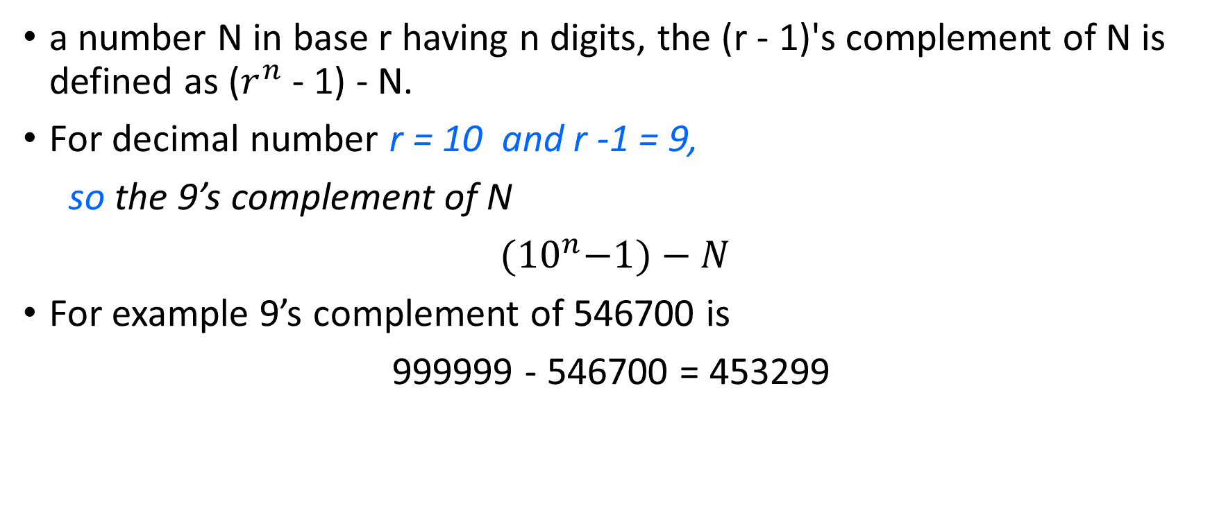
Diminished Radix Complement
a number N in base r having n digits, the (r - 1)'s complement of N is defined as ($r^{n}$ - 1) - N.
For decimal number r = 10 and r -1 = 9,
so the 9’s complement of N
${(10}^{n}−1)−N$
For example 9’s complement of 546700 is
999999 - 546700 = 453299

Slide 31

For binary number r = 2 and r -1 = 1,
so the 1’s complement of N
${(2}^{n}−1)−N$
For example
n = 4; $2^{4}=10000$
$2^{4}−1=1111 (binary representation)$
1011000 → 0100111
1’s complement of binary number is obtained by subtracting each digit from 1.

Slide 32
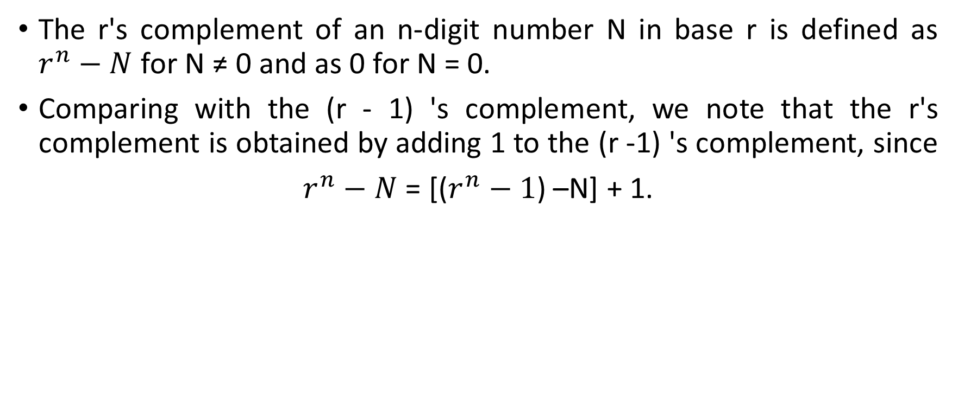
Radix Complement
The r's complement of an n-digit number N in base r is defined as $r^{n}−N$ for N ≠ 0 and as 0 for N = 0.
Comparing with the (r - 1) 's complement, we note that the r's complement is obtained by adding 1 to the (r -1) 's complement, since
$r^{n}−N$ = [($r^{n}−1$) –N] + 1.

Slide 33
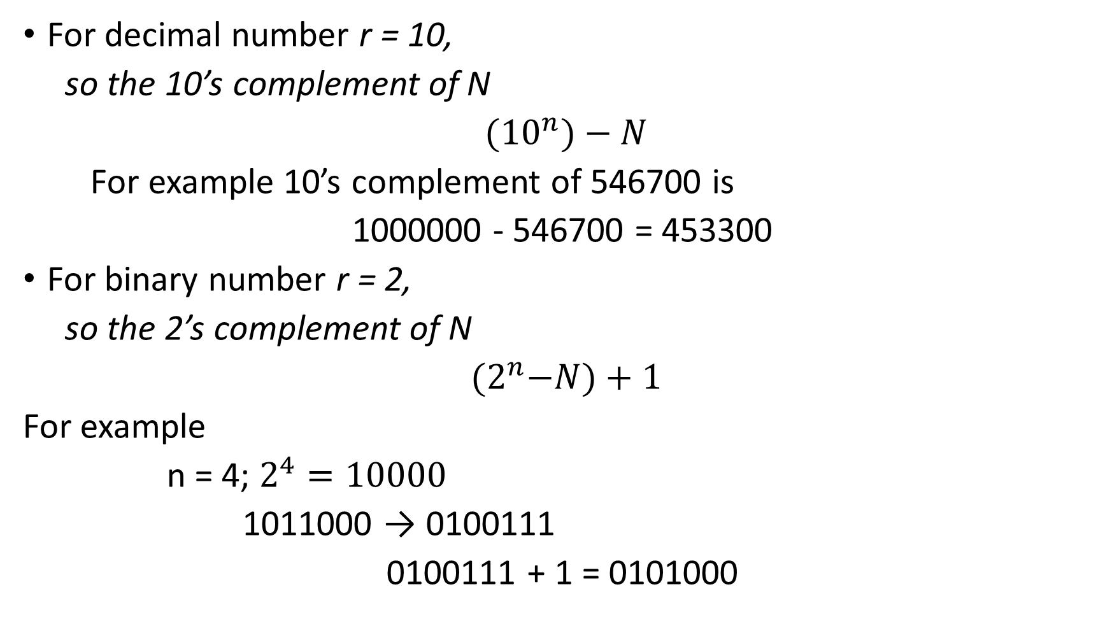
For decimal number r = 10,
so the 10’s complement of N
${(10}^{n})−N$
For example 10’s complement of 546700 is
1000000 - 546700 = 453300
For binary number r = 2,
so the 2’s complement of N
${(2}^{n}−N)+1$
For example
n = 4; $2^{4}=10000$
1011000 → 0100111
0100111 + 1 = 0101000

Slide 34
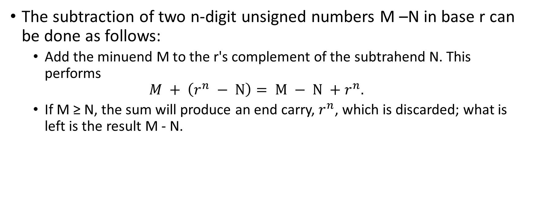
Subtraction with Complement
The subtraction of two n-digit unsigned numbers M –N in base r can be done as follows:
Add the minuend M to the r's complement of the subtrahend N. This performs
$$M + \left(r^{n} − N\right)= M − N +r^{n}.$$
If M ≥ N, the sum will produce an end carry, $r^{n}$, which is discarded; what is left is the result M - N.

Slide 35
Example
Using 10's complement,
subtract 72532 –3250
M = 72532
10’s complement of N = 96750
Sum 169282
Discard end carry 69282

Slide 36
Using 10's complement, subtract 3250 –72532
M = 03250
10’s complement of N = 27468
Sum 30718

Slide 37
Given the two binary numbers X = 1010100 and Y = 1000011, perform the subtraction
(a) X –Y and
(b) Y - X by using 2's complement.
X = 1010100
2’s complement of Y = 0111101
Sum 10010001
Discard end carry 0010001
Answer X-Y = 0010001

Slide 38
Y - X by using 2's complement.
X = 1000011
2’s complement of Y = 0101100
Sum 1101111
There is no end carry. Therefore, the answer is Y –X = -(2's complement of 1101111) = -0010001.

Slide 39
SIGNED BINARY NUMBERS
To represent negative integers, we need a notation for negative values.
It is customary to represent the sign with a bit placed in the leftmost position of the number.
The convention is to make the sign bit 0 for positive and 1 for negative.
Example
Signed – Magnitude representation: 10001001
Signed – 1’s – complement representation: 11110110
Signed – 2’s – complement representation: 11110111

Slide 40
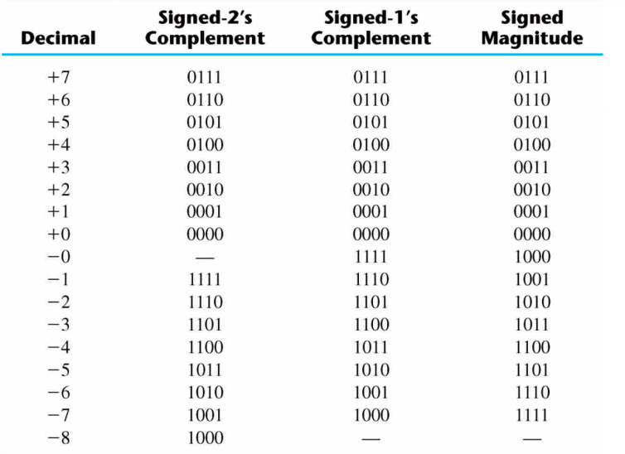
Signed binary number

Slide 41
Arithmetic Addition
The addition of two numbers in the signed-magnitude system follows the rules of ordinary arithmetic.
If the signs are the same, we add the two magnitudes and give the sum the common sign.
If the signs are different, we subtract the smaller magnitude from the larger and give the difference the sign if the larger magnitude.
The addition of two signed binary numbers with negative numbers represented in signed-2's-complement form is obtained from the addition of the two numbers, including their sign bits.
A carry out of the sign-bit position is discarded

Slide 42
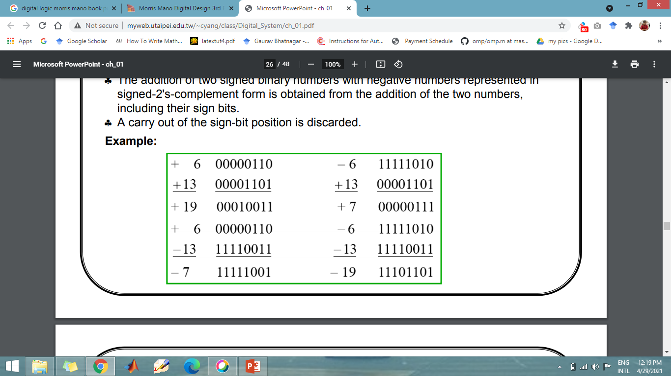
Example

Slide 43
Example

Slide 44
Example

Slide 45
Example

Slide 46
BCD code
A number with k decimal digits will require 4k bits in BCD. Decimal 396 is represented in BCD with 12bits as 0011 1001 0110, with each group of 4 bits representing one decimal digit. A decimal number in BCD is the same as its equivalent binary number only when the number is between 0 and 9. A BCD number greater than 10 looks different from its equivalent binary number, even though both contain 1's and 0's. Moreover, the binary combinations 1010 through 1111 are not used and have no meaning in BCD

Slide 47
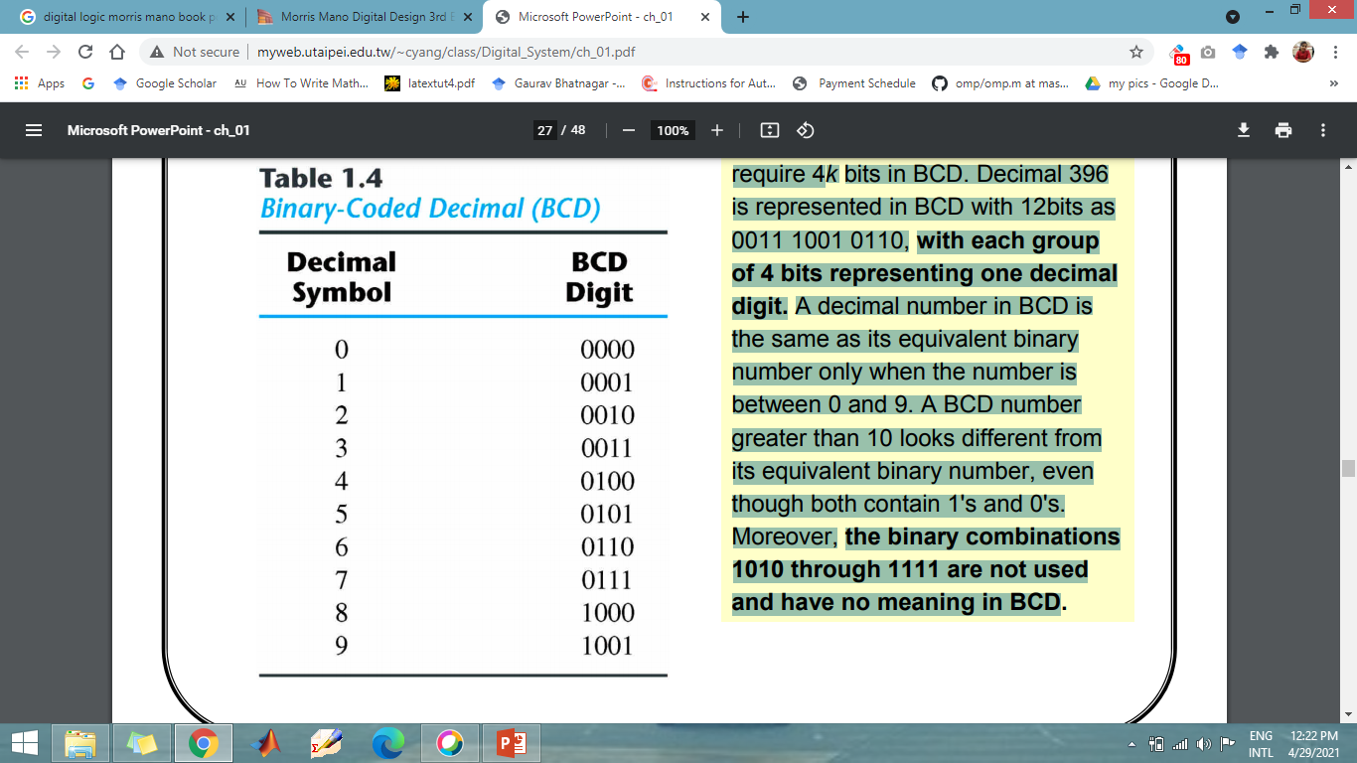
Table

